Slide 1


Slide 2
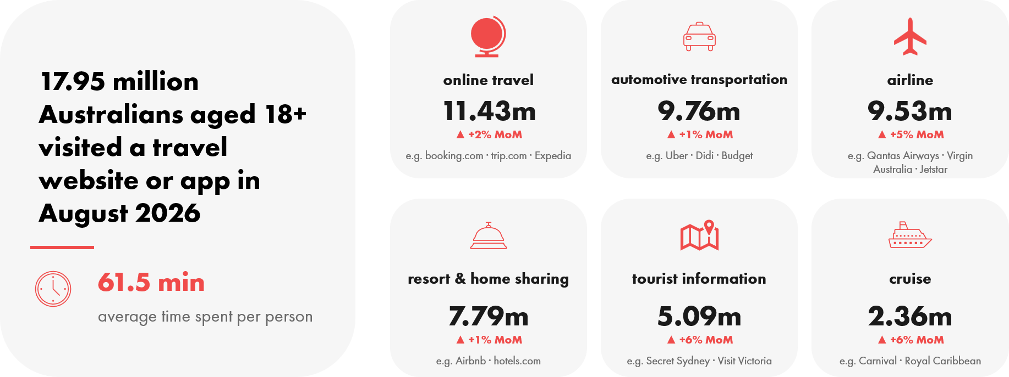


online travel audiences rise with summer holiday planning in august
Source: Ipsos iris Online Audience Measurement Service August 2026, (MoM July 2026 v August 2026), Age 18+, PC/laptop/smartphone/tablet, Travel category and selected sub-categories, Audience (000’s), Avg mins pp

Slide 3
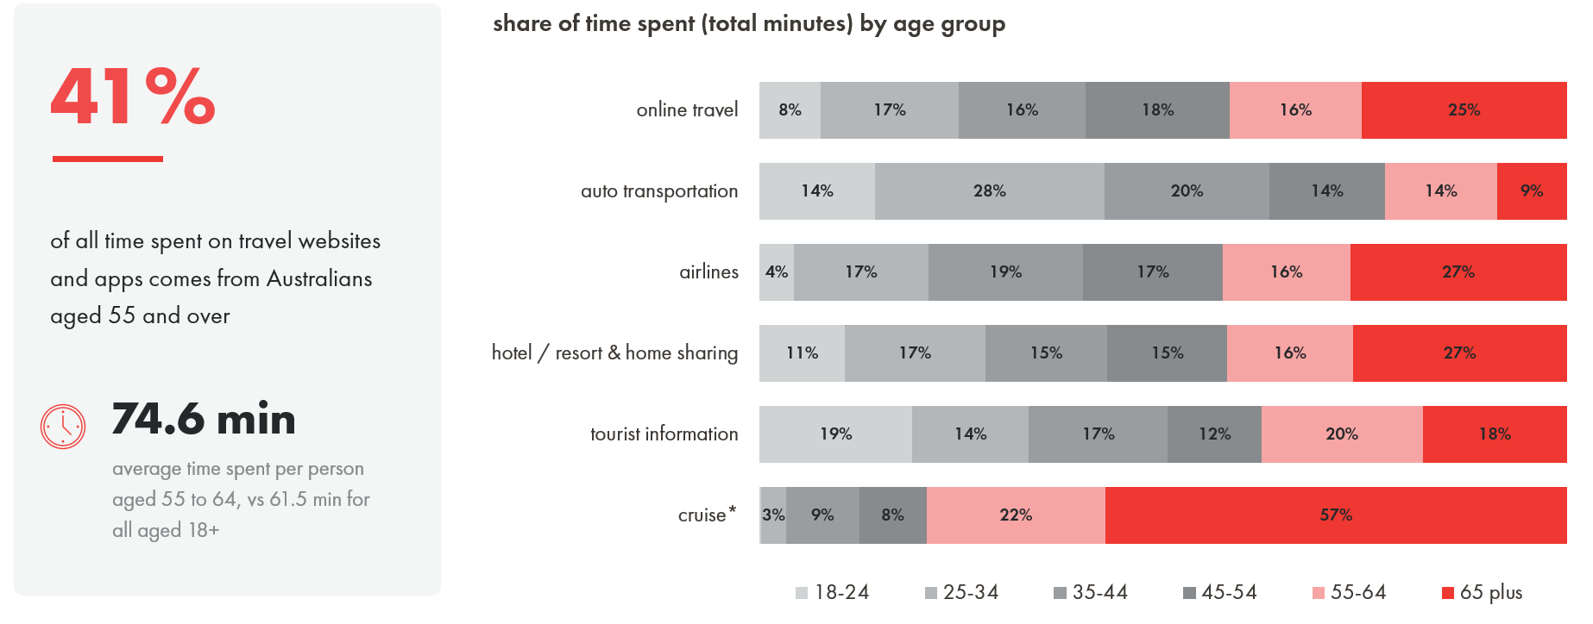
younger audiences spend more time on online travel, automotive transportation and tourist information website and apps
Source: Ipsos iris Online Audience Measurement Service August 2026, Age 18+, PC/laptop/smartphone/tablet, Travel category and selected sub-categories, Audience (000’s), Avg mins pp, Share of total time (total minutes)
*Note: segments below 1% are not labelled on the chart: cruise 18–24 = 0.2%.

Slide 4
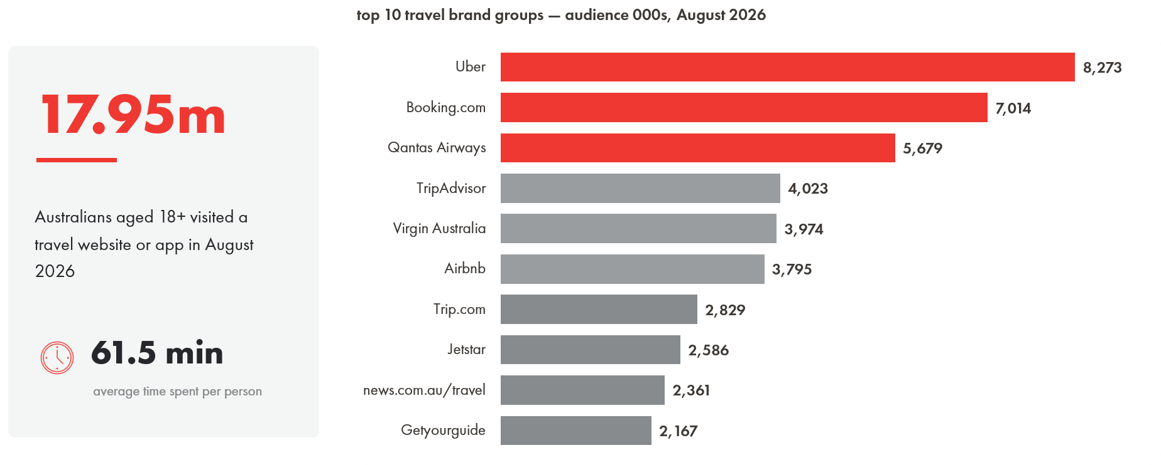
the online travel audience visited an average of 6 travel brands in August
Source: Ipsos iris Online Audience Measurement Service August 2026, Age 18+, PC/laptop/smartphone/tablet, Travel Category, Top 10 Brand Groups in Travel category, Audience (000’s), Avg mins pp

Slide 5
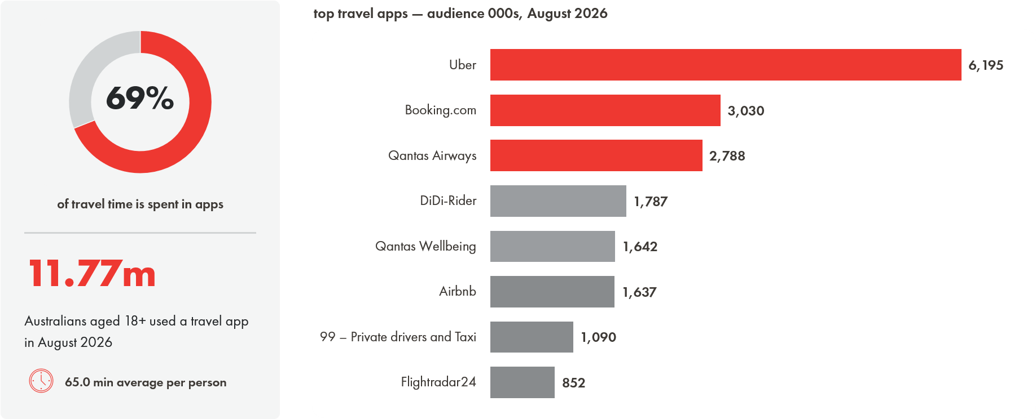
travel apps account for 69% of total time spent on online travel
Source: Ipsos iris Online Audience Measurement Service August 2026, Age 18+, PC/laptop/smartphone/tablet, Travel category apps, Top 8 Apps in Travel category, Audience (000’s), Avg mins pp, Share of total time (minutes)

Slide 6
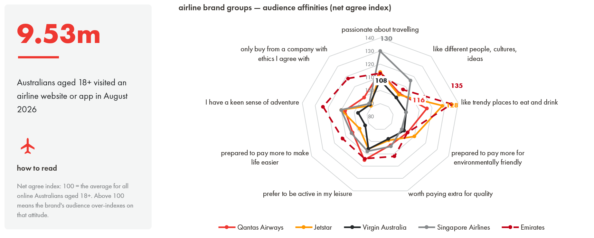
digital audiences of airline brands have distinct attitudes across a range of motivators
Source: Ipsos iris Online Audience Measurement Service August 2026, Age 18+, PC/laptop/smartphone/tablet, Airline sub-category, Selected Brand Groups in the Airline subcategory, Audience (000’s),
Audience Affinity Index (net agree)

Slide 7
18+
12,000
hybrid
Australians measured across smartphone, PC/laptop, tablet and CTV
establishment survey interviews a year, sizing the digital universe
passive single-source panel combined with site-centric census data
about Ipsos iris
Ipsos iris is the IAB Australia endorsed digital content measurement system for the planning, buying and reporting of digital audiences in Australia.
It is an inclusive, standardised currency providing a level playing field for comparison of digital audience reach and characteristics, along with other insights about Australians aged 18+ who access digital content and services on smartphone, PC/laptop, tablet and CTV devices.
From July 2026, Ipsos iris reports audiences aged 18+ only, excluding 14–17-year-olds. Due to this change, audience figures from July 2026 onwards cannot be compared with pre-July 2026 (14+) data, and growth or decline comparisons across this period are not valid.
Ipsos iris brings a hybrid methodology combining metered data from a high quality, nationally representative, single-source passive panel with site-centric census measurement. Ipsos conducts an establishment survey of 12,000 Australians per annum to capture digital device ownership and usage at both household and personal level. The survey creates the digital universe on which online audiences are projected and provides panel recruitment targets covering demographics and device ownership.
Data from the Ipsos iris digital currency and from the establishment survey is included in these nickable charts.
Further information is available at IAB Australia and Ipsos iris Australia.
source.
Ipsos iris — the IAB Australia endorsed digital audience measurement currency

