Slide 1
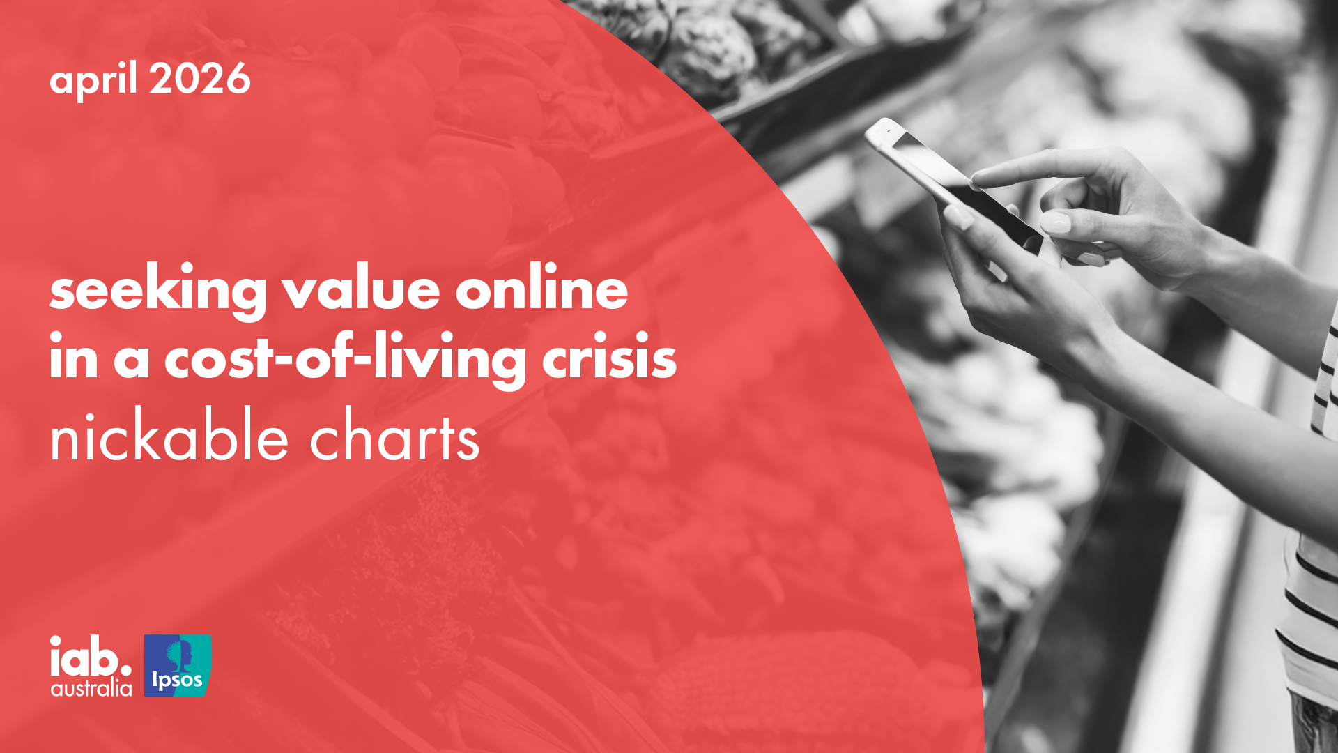

Slide 2
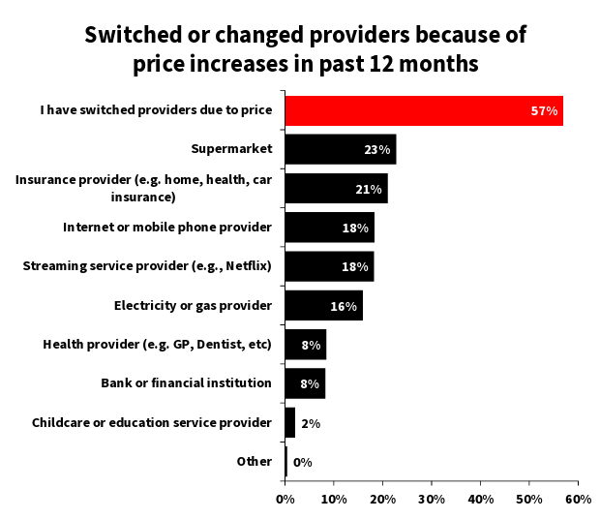


57% of Australians have switched a provider due to price increases
NAB’s consumer sentiment survey findings show that price increases are driving tangible changes in consumer behaviour.
Supermarkets were the most frequently switched category, underscoring groceries as the frontline of cost-of-living pressure. Insurance, internet and mobile services, streaming platforms and energy retailers have also seen elevated churn.
Source: NAB Consumer Sentiment Survey, Q1 2026

Slide 3
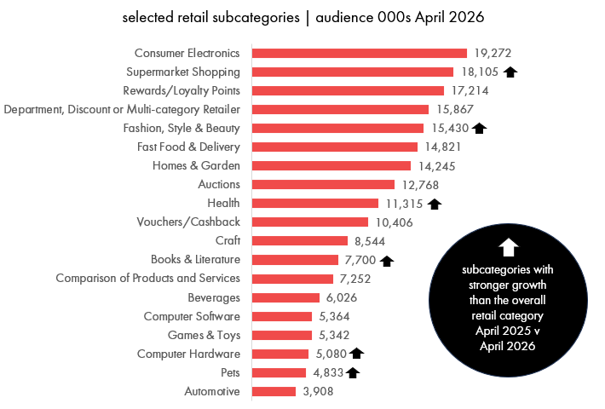


retailer websites and apps are helping Australians navigate cost-of-living pressures
Most Australians
(over 22.2 million) visited a retail or commerce website or app
in April 2026.
The overall category is up 2% year on year (April 2025 v April 2026).
Supermarkets, fashion, beauty, health, books, computer hardware and pets retail websites and apps have grown at a stronger rate than the overall category.
Source: Ipsos iris Online Audience Measurement Service April 2026 (year on year April 2025 v April 2026), Age 14+, PC/laptop/smartphone/tablet, Retail and Commerce category and selected subcategories, Audience (000)

Slide 4
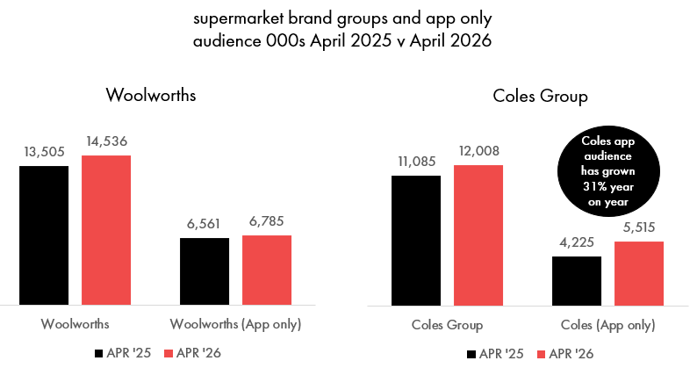

time spent on supermarket websites and apps is rising as Australians seek value and ways to control spending
Coles Group and Woolworths supermarket online audiences are both up 8% year on year (April 2025 v April 2026).
Coles grew to 12 million in April 2026, its highest audience on record.
Av time spent per person with Woolworths increased 18% year on year.
Source: Ipsos iris Online Audience Measurement Service April 2026 (year on year April 2025 v April 2026), Age 14+, PC/laptop/smartphone/tablet, supermarket subcategory, audience (000), average time pp (minutes)

Slide 5
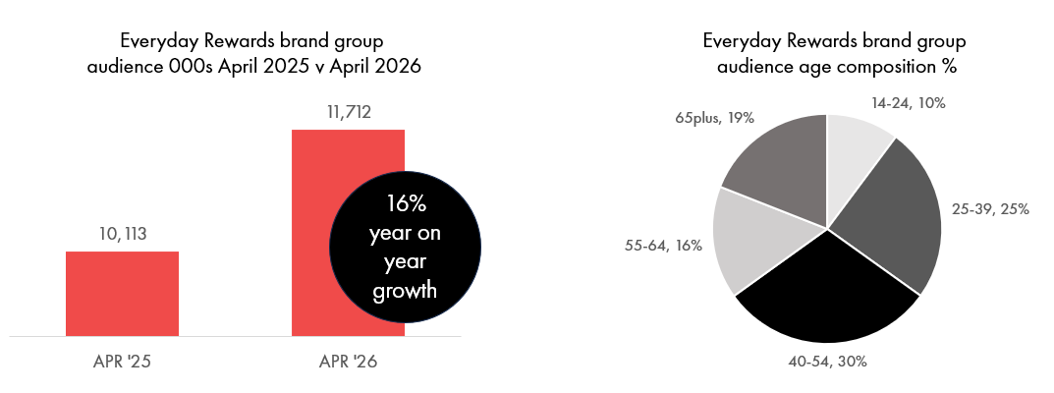
Australians are seeking more value through retailer loyalty and rewards programs
Australians using the Everyday Rewards website and app has increased to 11.7million in April 2026, the highest monthly audience on record. The audience is 20% more likely to be aged 40-54.
Source: Ipsos iris Online Audience Measurement Service April 2026 (year on year April 2025 v April 2026), Age 14+, PC/laptop/smartphone/tablet, Everyday Rewards Brand Group , audience (000), audience composition %

Slide 6
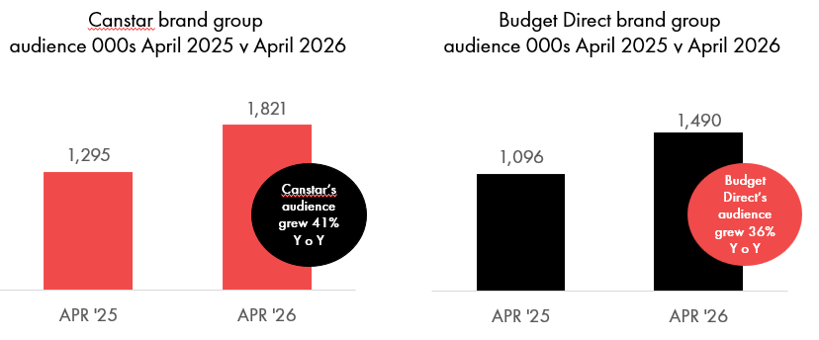

Australians are increasingly comparing financial products to manage cost-of-living pressures
7.3 million Australians used an online product comparison website or app (such as Finder, Canstar, WhistleOut) in April 2026.
Source: Ipsos iris Online Audience Measurement Service April 2026 (year on year April 2025 v April 2026), Age 14+, PC/laptop/smartphone/tablet, Comparison of Products and Services subcategory,
Canstar Brand Group, Budget Direct Brand Group, audience (000)

Slide 7
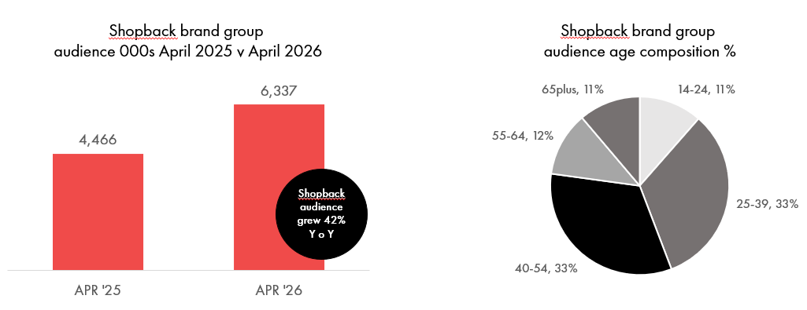
Australians are turning to cashback programs to offset rising costs
Australians using the Shopback website and app has increased to nearly 6.4 million in April 2026, up 42% year on year. Two-thirds of the audience are aged 25-54.
Source: Ipsos iris Online Audience Measurement Service April 2026 (year on year April 2025 v April 2026), Age 14+, PC/laptop/smartphone/tablet, Shopback Brand Group , audience (000), audience composition %

Slide 8
source
Ipsos iris, IAB endorsed digital audience measurement currency
Ipsos iris is the IAB Australia endorsed digital content measurement system for the planning, buying, and reporting of digital audiences in Australia.
Ipsos iris is an inclusive, standardised currency providing a level playing field for comparison of digital audience reach and characteristics, along with other insights about Australians aged 14+ who access the wide variety of digital content and services on Smartphone, PC/Laptop, Tablet and CTV devices.
Ipsos iris brings a hybrid methodology combining metered data from a high quality, nationally representative, single-source passive panel with site-centric census measurement.
Ipsos conducts an establishment survey of 12,000 Australians aged 14 and over per annum to capture their digital device ownership and usage at both a household and personal level. The survey is designed to create a digital universe on which to project online audiences and to provide panel recruitment targets covering demographics and device type ownership and usage.
Data from the Ipsos iris digital currency and from the establishment survey is included in these nickable charts.
Further insights and information on Ipsos iris is available at - iris-au.ipsos.com
Monthly rankings are available at - iris-au.Ipsos.com/rankings

